Slide 1

IT Support Ticket Management System Analysis
Performance Evaluation & Strategic Recommendations

Slide 2
Introduction and Objectives
Hook Statement:
With ticket volumes doubling from 13,051 in 2016 to 29,088 in 2020, our IT support system faces unprecedented demand. Are we equipped to handle this growth?
Project Context:
This analysis examines the IT support ticket management system across 97,498 tickets handled by 50 agents over five years (2016-2020), evaluating agent performance, resolution efficiency, and employee satisfaction.
Primary Objectives:
Identify high and low-performing IT agents
Assess overall team effectiveness and efficiency
Analyze ticket resolution processes and bottlenecks
Determine areas for improvement in service delivery
Provide data-driven recommendations for staffing decisions
Guide investment priorities for system upgrades

Slide 3


Data Overview
Dataset Summary
Key Performance Indicators
Total Records: 97,498 tickets
Analysis Period: January 2016 - December 2020
Number of Agents: 50
Attributes Analyzed: 15 (after enrichment)
Avg Daily Volume: 106.44 tickets
Avg Resolution Time: 4.55 days
Avg Satisfaction: 4.10/5.0
Average Agent Age: 40.48 years
Data Quality Initiatives:
No missing or duplicate values found
Corrected 97,498 inconsistencies in Severity and Priority columns
Fixed misspellings: 'Unassigned' (29,410), 'Major' (4,836), 'Unclassified' (356)

Slide 4
Methodology
Data Cleaning
Analysis Methods
Tools Used
ISBLANK & Filters
Remove Duplicates
Split Text to Columns
Find & Replace
Pivot Table Analysis
Statistical Functions
XLOOKUP
Correlation Analysis
Pivot Tables & Charts
Timeline Slicers
Dashboards
Conditional Formatting
Analytical Approach
Our methodology combined rigorous data cleaning with multi-dimensional analysis to ensure accuracy and reliability.
Used advanced Excel functions including AVERAGE, CORREL, COUNTIF, and XLOOKUP to derive actionable insights from the dataset.
Pivot tables enabled dynamic exploration of trends across time, agent performance, and ticket categories, while conditional formatting highlighted critical thresholds for decision-making & future impact over time.

Slide 5
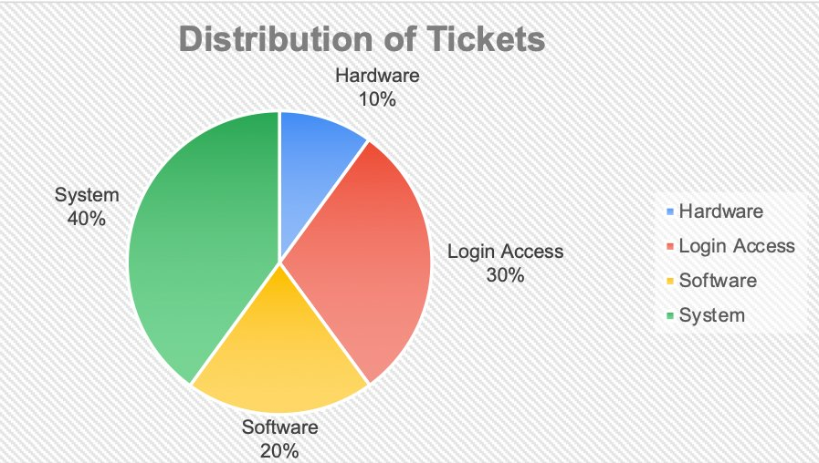
Ticket Distribution Analysis
Request Category Distribution
System Issues: 40.00% (39,002 tickets)
Login Access: 29.94% (29,193 tickets)
Software Issues: 20.07% (19,570 tickets)
Hardware Issues: 9.98% (9,733 tickets)
Key Observation
System & Login Access categories account for nearly 70% of all tickets, indicating these are the primary support areas requiring attention and resources to improve performance.

Slide 6
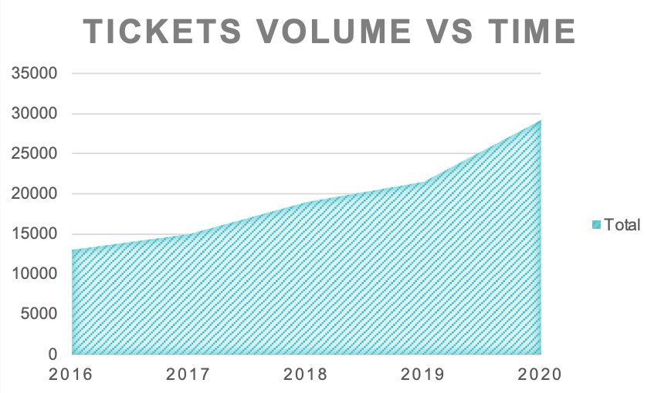
Ticket Volume Trends
Year-over-Year Analysis
2016: 13,051 tickets (Baseline)
2017: 14,915 (+14.3%)
2018: 18,954 (+27.1%)
2019: 21,490 (+13.4%)
2020: 29,088 (+35.4%)
Critical Insight
Ticket Volume more than Doubled (123% increase) over 5 years, particularly sharp growth in 2020, signaling grown IT infrastructure complexity.

Slide 7
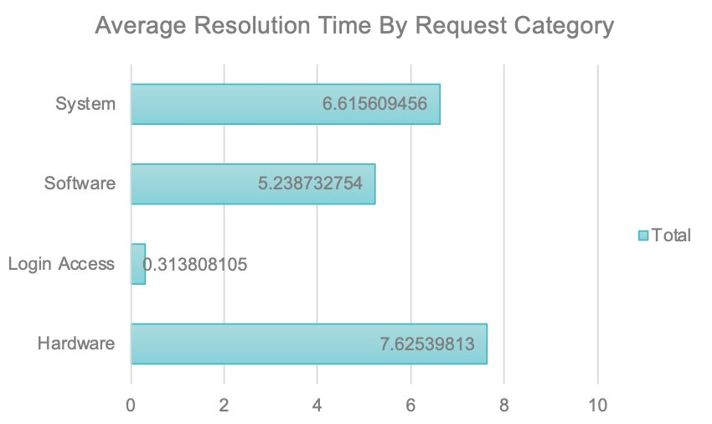
Resolution Time by Category
Performance by Category
Hardware: 7.63 days (67% above avg)
System: 6.62 days (45% above avg)
Software: 5.24 days (15% above avg)
Login Access: 0.31 days (93% below avg)
Overall Average: 4.55 days
Hardware, System, and Software categories all exceed average resolution time, indicating potential resource constraints or complexity issues. Login Access resolved exceptionally quickly.

Slide 8
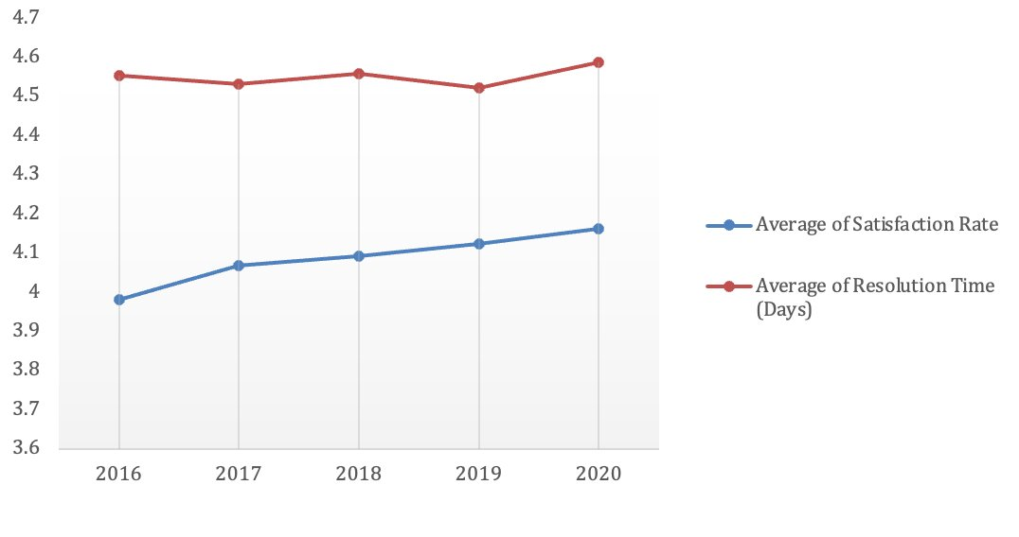
Team Performance Trends Over Time
Five-Year Performance Evolution
Resolution Time Trend
Remained remarkably consistent at ~4.5 days despite ticket volume doubling from 13,051 to 29,088.
Satisfaction Rate Trend
Steady improvement from 3.98 (2016) to 4.16 (2020), showing +4.6% increase in customer satisfaction.
Key Insight: Despite dramatic volume increase, the team maintained consistent resolution times & improved satisfaction, demonstrating resilience and adaptability.

Slide 9

Software Effectiveness Evaluation
Approximately 33% of all tickets incorrectly classified as HIGH PRIORITY despite having Normal Severity levels.
Impact of Misclassification
Trend Analysis
Misallocation of resources
Delayed attention to truly urgent issues
Agent confusion and inefficiency
Reduced system effectiveness
Before New Tools: Normal severity tickets appropriately assigned Low to Medium priority
After New Tools: Drastic increase in High Priority assignments for Normal severity issues
STRATEGIC IMPLICATION: Urgent need for software upgrade or reconfiguration to restore accurate ticket classification.

Slide 10
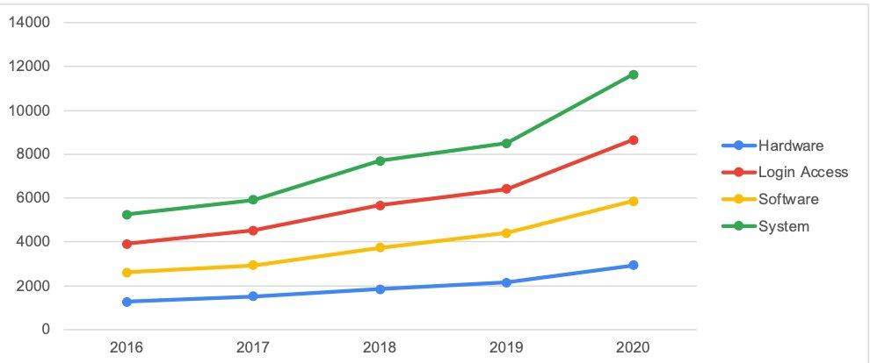
Technology Investment Analysis
Ticket Growth by Category
Hardware: +131% (1,272 → 2,933)
Login Access: +121% (3,910 → 8,659)
Software: +124% (2,617 → 5,865)
System: +121% (5,252 → 11,631)
Investment Recommendation
Yes - Significant technology investment is essential. The dramatic increase across ALL categories suggests underlying infrastructure issues. Investment addresses root causes, providing long-term savings through prevention rather than reactive support.

Slide 11
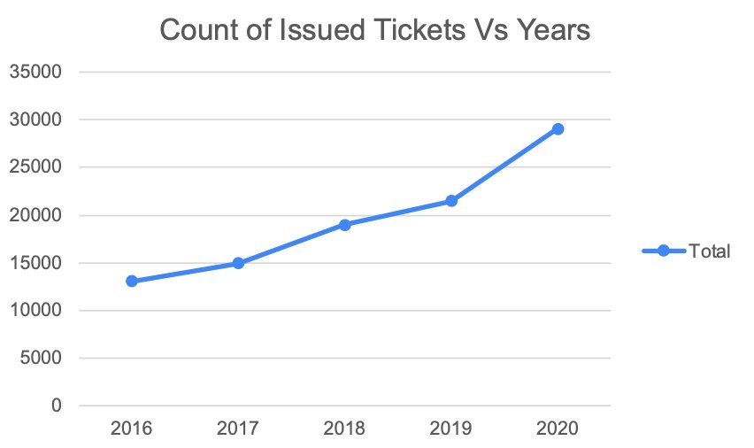
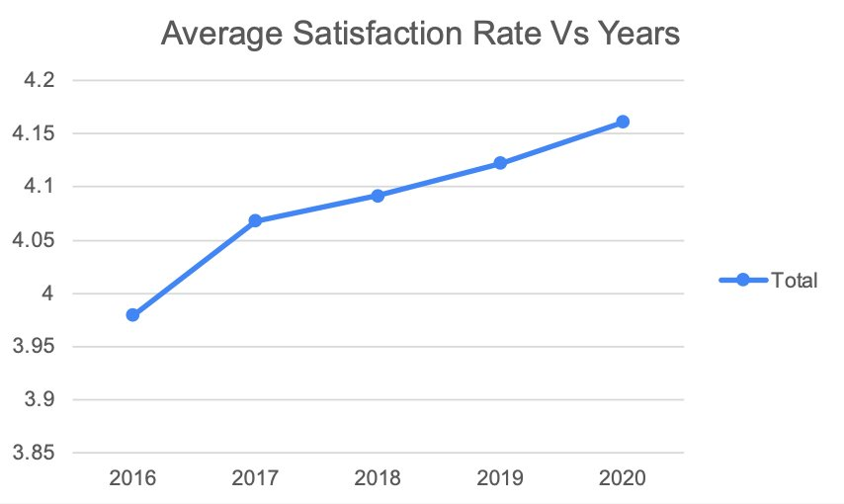
Peak and Stable Periods
Ticket Volume Patterns
Satisfaction Trends
Peak Period: 2020 (29,088 tickets). Stable Period: 2016-2017. No seasonal stability - volume consistently increased.
Peak Satisfaction: 2020 (4.16). Steady improvement year-over-year. Excellent performance under pressure.

Slide 12
Dashboard Analysis | Satisfaction & Resolution Time
Key Insights
QUALITY
Over 80% of tickets scored satisfaction 4 or 5 — confirming overall team quality is strong despite high volumes.
RESOLUTION
Resolution time ranges 0–14 days for 97% of tickets, with majority resolved within 6 days, indicating a healthy distribution.
RECOMMENDATION
Maintain current team quality practices; introduce satisfaction tracking per agent to sustain the high 4–5 score rate.

Slide 13
Dashboard Analysis | Severity & Category Trends Over Time
Key Insights
SEVERITY
CATEGORY
Normal severity tickets dominate every year doubling in 2020 ( 26493 ), 2017 ( 11794 ) signals systemic scale-up pressure.
System category is most resource-intensive, with largest share of ticket volume & growing 121% from 2016 to 2020 (5,252 → 11,631).
RECOMMENDATION
Allocate additional System-category specialists & introduce a fast-track queue for urgent tickets to prevent escalation delays.

Slide 14
Dashboard Analysis | Resolution Time & Age Group Satisfaction
Key Insights
HARDWARE
Hardware consistently records the highest resolution time (7.63 days avg) — 67% above the 4.55-day overall average across every quarter in both 2016 and 2020.
EXPERIENCE
Agents aged 25–55 improved satisfaction rates over the years despite handling higher volumes, confirming experience directly drives better service quality.
RECOMMENDATION
• Dedicate a Specialized Hardware team with faster escalation protocols • Pair Junior Agents (25–34) with Senior Agents (35–55) in a structured mentorship program

Slide 15

Strategic Recommendation: Investment Priorities
Three-Pillar Evaluation:
1. Agent Workload
2. Training Needs
3. Software (CRITICAL)
12 overloaded agents
12 underloaded agents
Action: Hire additional agents
13 agents has high resolution times
1 agent with low satisfaction rate
Action: Enforce Targeted Training
33% misclassification rate
Performance decline
Action: Upgrade Software Fast
PRIMARY INVESTMENT DECISION
Prioritize Ticket Management Software Upgrade
The 33% misclassification rate represents a critical system failure that undermines all other improvements. This should be addressed before scaling the team.

Slide 16
Strategic Recommendation: Agent Performance
High-Performers: 36 out of 50 agents meet or exceed performance standards
Training Required
Performance Improvement Plan
13 Agents has resolution times >5.2 days 1 Agent Satisfaction Rating <3.5 Action: Training in Troubleshooting, Customer Service
Agent 19: Lowest satisfaction rate (3.04/5.0). Action: Place under notice with 90-day improvement plan
Agents Recommended for Termination
Agent 13: Low ticket volume (<25th percentile) + High resolution time (>75th percentile)
Agent 49: Low ticket volume (<25th percentile) + High resolution time (>75th percentile)
Rationale: Consistently underperforming on both productivity and efficiency metrics

Slide 17
Conclusion
Performance Strengths
Critical Challenges
Consistent resolution despite 123% vol increase
Satisfaction improved by 4.6% over five years
72% of Agents meet or Exceed Standards
Efficient Login Access handling (0.31 Day Avg)
Software misclassifies 33% of tickets
Hardware / System tickets 45-67% slower
Significant workload imbalance
2 agents below acceptable standards
Strategic Actions Required:
IMMEDIATE: Upgrade ticket management software
SHORT-TERM: Terminate Agents 13 & 49; implement improvement plan for Agent 19
MEDIUM-TERM: Hire additional agents to balance workload
ONGOING: Invest in technology infrastructure to reduce Hardware/System tickets
Impact: Enhanced service quality, improved efficiency, reduced resolution times, and readiness for continued growth

Slide 18
Thank You
Questions & Discussion
Data-Driven Decisions for IT Excellence

